Slide 1
We take the lead for a sustainable society
Notes:
KTH:s vision – We take the lead for a sustainable society
In November 2023, the KTH board adopted a new vision and overarching goals to guide the university from 2024 and beyond.
The vision emphasizes KTH’s responsibility to lead the transition to a sustainable society – through research and education, but also by being a global actor grounded in academic freedom, openness, and diversity.
It serves as a compass, clarifying our purpose and the change we want to drive in the world.

Slide 2
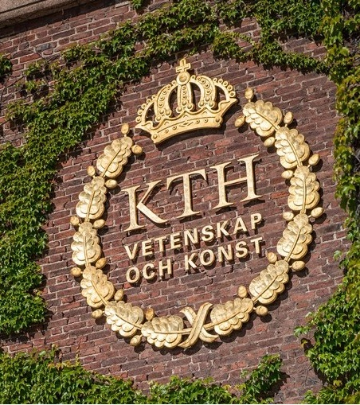
We take the lead for a sustainable society
Vision
KTH shapes the future through education, research and innovation. Situated in one of the world’s most dynamic cities, we stand as a unifying force internationally to tackle global challenges. We embrace diversity and attract talent from across the globe. Together we bring ideas to life. Our academic freedom and principles of openness and transparency are fundamental to democracy and the advancement of knowledge. We are bold, creative, and responsible, driven by our purpose to enable sustainable and gender-equal societies.

Slide 3

Overall goals
Education
KTH’s education shall be of the highest quality and internationally competitive.
Working and study environment
KTH’s working and study environment shall be attractive, inclusive and equal.
Research
KTH’s research shall be world-leading and have a major impact.
Efficient, sustainable resource management
KTH’s working methods shall be efficient, sustainable and forward-looking.
Notes:
Overall goals for the period 2024–2028
Education
KTH’s education shall be of the highest quality and internationally competitive.
Working and study environment
KTH’s working and study environment shall be attractive, inclusive and equal.
Research
KTH’s research shall be world-leading and have a major impact.
Efficient, sustainable resource management
KTH’s working methods shall be efficient, sustainable and forward-looking.
Overall goals for the period 2024–2028
Eduaction
KTH’s education shall be of the highest quality and internationally competitive
KTH shall educate a wide range of engineers, architects, teachers, and researchers who can lead the transformation to a sustainable, gender-equal world. Our education programs shall advance knowledge in society and meet the job market’s need for highly qualified labour and flexible continuing professional development.
Our education programs shall be relevant to a rapidly changing world and be characterised by pedagogic renewal, student-centered learning, research-based knowledge, and flexible study paths. There shall be a close link between education and research, with teachers who both teach and conduct research. We shall develop our students’ practical professional skills and their ability to think innovatively through interactive teaching solutions, open experimental environments, and close collaborations with industry and other societal stakeholders. Students shall develop critical thinking and collaborative skills in their education programs to be able to manage complex challenges responsibly. We shall develop responsible entrepreneurship among students and provide them with what they need to transform ideas into reality. We shall offer good opportunities for student exchanges that promote international perspectives.
Research
KTH’s research shall be world-leading and have a major impact
KTH shall conduct excellent basic research and applied research in strong international research environments characterised by openness, integrity, and academic freedom. We shall be a global driving force for bringing together different resources and areas of expertise in research and innovation. We shall contribute to the transformation needed for a sustainable society through interdisciplinary approaches and collaboration with leading universities, industry, and other societal stakeholders.
Our teachers and researchers shall have the competitive conditions in place to conduct research, and we shall have the capacity to strategically recruit leading international academics. We shall promote strong academic leadership, and our research environments shall be inclusive and equal. Our research infrastructures shall be of high quality and promote groundbreaking research and knowledge exchange. Our research shall uphold high credibility, follow sound research ethics, and be transparent and accessible. KTH shall play an active role at European and national levels in the development of research policy and funding.
Working and study environment
KTH’s working and study environment shall be attractive, inclusive and equal
KTH’s success is built by our staff and students. We shall attract outstanding teachers, researchers, and ambitious students from around the world. We shall attract the right expertise to our support services, contributing to the quality of our education and research. We shall be an international, development-oriented university characterised by gender equality, diversity, and equal opportunities. The varying characteristics, backgrounds, and cultures of our staff and students are assets that promote high quality in the operation of the university. Our campuses shall be sustainable, vibrant, and accessible.
The working environment shall be creative and safe, where staff thrive and have what they need to succeed in their jobs. We shall value a work-life balance for our staff and offer flexible working solutions. Our staff shall have good opportunities for career progression and continuing professional development.
The study environment shall be safe and characterised by a rich, inclusive student life that offers experiences, social connections, and added value for students’ long-term development. Our physical and digital learning and studying environments shall support collaboration and interaction between students and teachers.
Efficient, sustainable resource management
KTH’s working methods shall be efficient, sustainable and forward-looking
KTH shall have the ability to set priorities and make changes to improve the efficiency and quality of the university’s operations. Our finances shall be in balance, and we shall use our resources in a responsible, sustainable manner. We shall have simple processes that are fit for purpose, and the support for education and research shall be efficient and easily accessible. Digital solutions shall simplify administration and be used to develop operations. We shall have efficient, long-term premises planning with climate-smart buildings designed according to the needs and conditions of our operations.
Our organisation shall have a clear division of responsibilities, efficient preparatory work, and swift decision paths. Collegiality, co-workership, and student influence shall be fundamental to our development work, and we shall have leadership that promotes participation by all staff. A strong, forward-looking quality culture shall permeate our work to monitor and develop operations.

Slide 4

Overall goals
Education
KTH’s education shall be of the highest quality and internationally competitive.
Working and study environment
KTH’s working and study environment shall be attractive, inclusive and equal.
Research
KTH’s research shall be world-leading and have a major impact.
Efficient, sustainable resource management
KTH’s working methods shall be efficient, sustainable and forward-looking.
Notes:
Overall goals for the period 2024–2028
Education
KTH’s education shall be of the highest quality and internationally competitive.
Working and study environment
KTH’s working and study environment shall be attractive, inclusive and equal.
Research
KTH’s research shall be world-leading and have a major impact.
Efficient, sustainable resource management
KTH’s working methods shall be efficient, sustainable and forward-looking.
Overall goals for the period 2024–2028
Eduaction
KTH’s education shall be of the highest quality and internationally competitive
KTH shall educate a wide range of engineers, architects, teachers, and researchers who can lead the transformation to a sustainable, gender-equal world. Our education programs shall advance knowledge in society and meet the job market’s need for highly qualified labour and flexible continuing professional development.
Our education programs shall be relevant to a rapidly changing world and be characterised by pedagogic renewal, student-centered learning, research-based knowledge, and flexible study paths. There shall be a close link between education and research, with teachers who both teach and conduct research. We shall develop our students’ practical professional skills and their ability to think innovatively through interactive teaching solutions, open experimental environments, and close collaborations with industry and other societal stakeholders. Students shall develop critical thinking and collaborative skills in their education programs to be able to manage complex challenges responsibly. We shall develop responsible entrepreneurship among students and provide them with what they need to transform ideas into reality. We shall offer good opportunities for student exchanges that promote international perspectives.
Research
KTH’s research shall be world-leading and have a major impact
KTH shall conduct excellent basic research and applied research in strong international research environments characterised by openness, integrity, and academic freedom. We shall be a global driving force for bringing together different resources and areas of expertise in research and innovation. We shall contribute to the transformation needed for a sustainable society through interdisciplinary approaches and collaboration with leading universities, industry, and other societal stakeholders.
Our teachers and researchers shall have the competitive conditions in place to conduct research, and we shall have the capacity to strategically recruit leading international academics. We shall promote strong academic leadership, and our research environments shall be inclusive and equal. Our research infrastructures shall be of high quality and promote groundbreaking research and knowledge exchange. Our research shall uphold high credibility, follow sound research ethics, and be transparent and accessible. KTH shall play an active role at European and national levels in the development of research policy and funding.
Working and study environment
KTH’s working and study environment shall be attractive, inclusive and equal
KTH’s success is built by our staff and students. We shall attract outstanding teachers, researchers, and ambitious students from around the world. We shall attract the right expertise to our support services, contributing to the quality of our education and research. We shall be an international, development-oriented university characterised by gender equality, diversity, and equal opportunities. The varying characteristics, backgrounds, and cultures of our staff and students are assets that promote high quality in the operation of the university. Our campuses shall be sustainable, vibrant, and accessible.
The working environment shall be creative and safe, where staff thrive and have what they need to succeed in their jobs. We shall value a work-life balance for our staff and offer flexible working solutions. Our staff shall have good opportunities for career progression and continuing professional development.
The study environment shall be safe and characterised by a rich, inclusive student life that offers experiences, social connections, and added value for students’ long-term development. Our physical and digital learning and studying environments shall support collaboration and interaction between students and teachers.
Efficient, sustainable resource management
KTH’s working methods shall be efficient, sustainable and forward-looking
KTH shall have the ability to set priorities and make changes to improve the efficiency and quality of the university’s operations. Our finances shall be in balance, and we shall use our resources in a responsible, sustainable manner. We shall have simple processes that are fit for purpose, and the support for education and research shall be efficient and easily accessible. Digital solutions shall simplify administration and be used to develop operations. We shall have efficient, long-term premises planning with climate-smart buildings designed according to the needs and conditions of our operations.
Our organisation shall have a clear division of responsibilities, efficient preparatory work, and swift decision paths. Collegiality, co-workership, and student influence shall be fundamental to our development work, and we shall have leadership that promotes participation by all staff. A strong, forward-looking quality culture shall permeate our work to monitor and develop operations.

Slide 5
Sweden’s largest technical university
Students
15,500
Full time equivalent students
Research
Education
35%
Women
3,700
International students
1,700
Doctoral students
Staff
4,100
Employees (FTE)
Alumni
175,000 alumni
in 115 countries
850
Faculty
20
international alumni associations
369
Professors
2,900
Staff within research
1,700
Doctoral students with employment
Notes:
KTH is Sweden’s largest and oldest university of technology and was founded in 1827.
KTH is a research intensive university, with 70% of total funding allocated to research. The main reason is KTH’s success in securing external funding, which accounts for more than half of research funding (62%).
KTH has:
Students
15,460 full time equivalent students (FTE students)
More than one third (35%) are women
Approximately 3,700 international students. This figure is an estimate based on the assumption that external master’s students, double degree students in the Master of Science in Engineering programmes, and some students in double master’s programmes are international. Some of these students are probably Swedish, and some international students may be missing from the calculation. These effects are expected to broadly balance out.
1,700 doctoral students (headcount)
Total number of students: 25,000 (headcount)
Staff
4,100 employees (FTE), including:
Approximately 2,900 in research, including:
368 professors
1,050 employed doctoral students (FTE)
Faculty includes:
Professors: 366
Visiting professors: 3
Associate professors: 240
Assistant professors: 61
Lecturers: 174
Alumni
More than 175,000 alumni in over 100 countries
More than 20,000 alumni live abroad
20 international alumni associations
Figures above 500 have been rounded to the nearest 50.
Figures above 10,000 have been rounded to the nearest 100.
Figures above 100,000 have been rounded to the nearest 1,000.
Updated 26 April 2026
Sources: LinkedIn, HR+, Ladok, KTH Annual Report 2025
Total number of peer reviewed scientific publications: 3,125. The 2025 figure needs to be updated.
Anders Söderholm has been President of KTH since 1 December 2022. Before joining KTH, he served for five years as Director General of the Swedish Higher Education Authority, UKÄ. Anders Söderholm has held a number of positions in the academic sector. His academic background is at Umeå University, where he received his PhD in 1991 with a thesis on municipal industrial policy. He has been Professor of Business Administration and has worked as a researcher and teacher in Industrial Economics and Management at KTH from 1998 to 1999 and from 2003 to 2004. As President, one of his goals is for KTH to continue developing as a leading international university of technology for a sustainable future. Read more here: https://www.kth.se/en/om/rektor

Slide 6
Alumni
29%
28%
6%
Consulting firms
Research and technology-
intensive industry
Research &
teaching
57%
6%
6%
5%
of KTH students are employed before their graduation
Public administration &
interest organizations
Infrastructure
service
Other manufacturing
industry
…
2%
2%
18%
Trade & brokerage
Process industry
Other
Notes:
Employers, both nationally and internationally, highly seek graduates from KTH.
Strong theoretical knowledge coupled with practical skills and the ability to adapt to various work environments make them ideal candidates for a wide range of industries.
The majority of KTH's alumni work at consulting firms or in research and technology-intensive industries.
57% of KTH students are employed before their graduation.
Source
Page 21 Career Report 2021:
https://static.sys.kth.se/uf/plu/karriarenkat/Rapport.2021.pdf
The report is based on a survey sent to all alumni who graduated in 2016, 2017, and 2018. Data collection took place during the spring and summer of 2021.
(There is currently no later report)

Slide 7
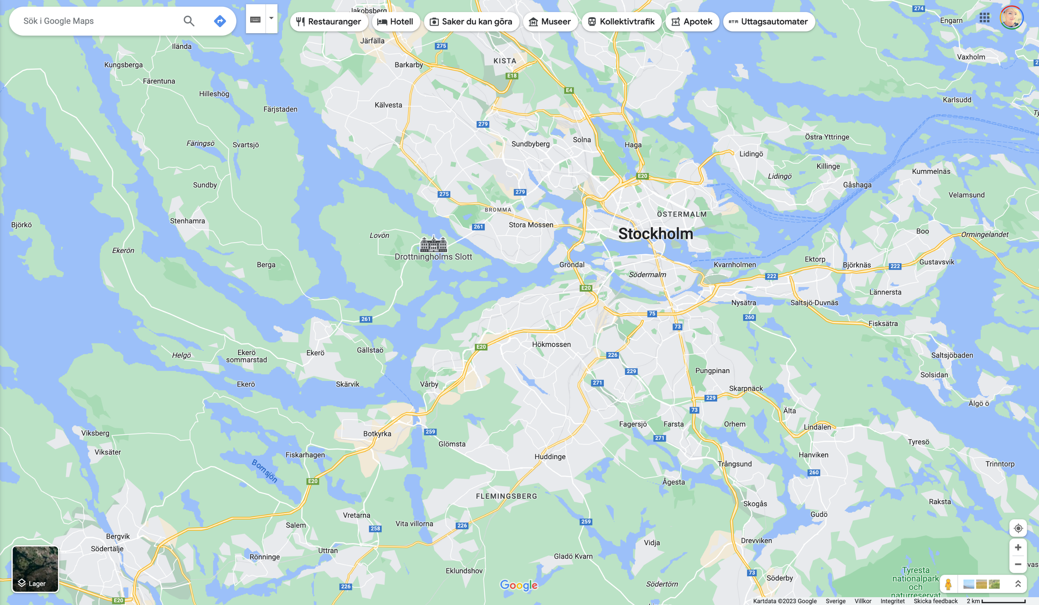




KTH Campus
KTH Solna
KTH Flemingsberg
2 km
Notes:
KTH operates across several campuses in the Stockholm region, each contributing to education, research, and collaboration with society and industry.
The main campus in central Stockholm is the largest and best known, with a strong international profile and focus on sustainability.
In autumn 2023, KTH’s board decided to relocate activities in Södertälje and Kista. These will gradually move to the main campus, while the Technical Preparatory Year will be offered at Campus Flemingsberg.

Slide 8
KTH’s School and Departments
ABE
EECS
ITM
CBH
SCI
Architecture
and the
Built Environment
Electrical Engineering and Computer Science
Industrial Engineering and Management
Engineering Sciences in Chemistry, Biotechnology
and Health
Engineering Sciences
Architecture
Civil and Architectural Engineering
Philosophy and History
Real Estate and Construction Management
Sustainable Development, Environmental Science
and Engineering
Urban Planning and Environment
Computer Science
Electrical Engineering
Human Centered Technology
Intelligent Systems
Energy Technology
Industrial Economics and Management
Learning in Engineering Sciences
Engineering Design
Materials Science and Engineering
Production Engineering
Biomedical Engineering
and Health Systems
Chemistry
Chemical Engineering
Engineering Pedagogics
Fibre and Polymer Technology
Gene Technology
Industrial Biotechnology
Protein Science
Applied Physics
Engineering Mechanics
Mathematics
Physics
Notes:
KTH consists of five schools, each with its own departments in fields like technology, natural sciences, architecture, industrial economics, social planning, and learning.

Slide 9



International rankings
3
32
7
In the Nordic region
In Europe
Mechanichal Engineering
66
72
40
Sustainability Ranking
THE Impact Rankings
Automation & Contol
74
95
43
In the world
in the world
in Mathematics
2025
2025
2024
Notes:
This slide shows KTH’s highest rankings in the QS, ARWU and THE lists for 2024 and 2025.
International ranking lists that measure a university’s excellence within research, education and collaboration have gained ever increasing coverage in society.
Ranking lists provide simple and readily accessible information about a university and its quality, and universities are ranked on both a general level and based on a subject-related assessment.
The various ranking lists use several indicators, that differ between the lists, to determine a university’s ranking and points score.
Why are rankings important?
With the growth of the international education market, ranking is crucial for the recruitment of students.
Alumni from ranked universities often have better opportunities to gain more highly qualified employment
Recruitment of teachers and researchers
Opportunities for more international collaborations with very prestigious universities
Larger allocation of competitive research funding announcements and investments in excellence
Source: QS, ARWU, THE, topuniversities.com

Slide 10
Rankings development
104
89
110
74
98
2015
2019
2021
2023
2025
187
155
155
95
201-250
2015
2019
2021
2023
2025
Notes:
Changes in KTH's placement in QS and THE over the past ten years.

Slide 11

KTH’s role in shaping today and tomorrow
Responsibility and purpose - we are here to help build a sustainable society for generations to come
Education
Research
Collaboration
Integration and working methods
Resource management
Climate
Notes:
Our Role: Shaping Today and Tomorrow
At KTH, Sweden’s largest technical university, we see ourselves as both educators and changemakers. Our responsibility extends beyond campus—we are here to help build a sustainable society for generations to come.
BRIEF BULLETS
Education
Giving Students Opportunities to Shape the Future
Research
Enabling Researchers to Find Solutions
Collaboration
Creating Societal Benefit
Integration and working methods
Embedding sustainability in every decision
Resource management
Minimizing impact through smart and responsible use of resources
Climate
Action for a climate-neutral future
DETAILED BULLETS
Education is our foundation. We equip every student with the knowledge, skills, and mindset to become leaders in sustainability—ready to tackle global challenges and create positive change throughout their careers.
Research is our engine. Our researchers push boundaries, seeking innovative solutions for a sustainable future.
Collaboration is our amplifier. By working with industry, governments, and communities, we turn knowledge into action and create real-world impact—locally and globally.
Integration and working methods are our guide: We embed sustainability into every part of KTH—strategies, operations, and everyday decisions such as what we eat to how we recycle—ensuring it’s not an add-on, but a core value.
Examples:
All KTH programs and courses are systematically reviewed and updated to include sustainability and equality.
Employees receive training in sustainable development and climate through targeted courses and coaching.
Sustainability is a mandatory criterion in recruitment and staff development plans.
Resource management. We use resources responsibly, always considering the long-term ecological, economic, and social impacts of our consumtion and use of materials and energy.
Examples:
KTH sets clear sustainability requirements in all procurement processes.
By 2025, KTH aims to reduce total waste per student and employee by 25% (compared to 2019) and increase recycling and reuse.
Energy use per person and per square meter is being cut by 25% (from 2015 levels), and new buildings must have lower climate impact than those built in 2015.
Climate objectives. We have set ambitious targets to achieve climate neutrality and minimize our environmental footprint, leading by example, consciously considering our impacts in purchasing, travel and energi use.
Examples:
The university follows a detailed action plan aligned with the 1.5-degree target, including a 60% reduction in total climate impact per full-time equivalent by 2030 (compared to 2015).
KTH aims for full climate neutrality (Scopes 1, 2, and 3) by 2045.
At KTH, we believe in action. We don’t just respond to global challenges—we help shape a better tomorrow.
(Sources: KTH Vision, Sustainability Policy, Sustainability Objectives, Ethical Policy)

Slide 12

Driving Sustainability Everyday
Leadership
Strategic & Active Environmental Management
Protecting the environment
Continuous Improvement
Lifecycle perspective
Participation and ownership
Notes:
NEW
KTH works every day to advance sustainability—both through our core activities and by actively managing and reducing our environmental impact.
Our approach is built on six tracks, each supported by concrete actions:
Leadership
At KTH, environmental management is promoted at all levels—from top management to every department and team. This ensures sustainability is not just a vision but a lived value throughout the organization.
For example, KTH’s management reviews and sets annual sustainability targets.
Each school is responsible for local implementation.
Regular sustainability workshops for leadership teams keep environmental management a top priority.
Strategic & Active Environmental Management
We take a strategic and active approach by integrating environmental goals into our strategic planning.
Sustainability are included in KTH’s strategic plans and annual reports.
Our Environmental Management System is ISO 14001 certified, ensuring systematic work with compliance, risk management, and continuous improvement.
Protecting the Environment
We are committed to protecting the environment through pollution reduction, sustainable resource use, climate action, and biodiversity protection.
For instance, KTH works to reduce energy use per square meter by installing smart building controls.
One Planet Plate is now the standard for all food ordered for meetings and events at KTH, ensuring every meal has a maximum climate impact of 0.5 kg CO₂e and promotes biodiversity by prioritizing plantbased foods.
On campus, pollinator habitats, and biodiversity-friendly landscaping support local ecosystems.
We are actively phasing out hazardous chemicals in labs and operations.
Continuous Improvement
Continuous improvement is at the heart of our environmental performance.
Our waste management system introduced new sorting stations, leading to a 25% reduction in waste per student and employee since 2019.
We retrofit buildings to improve energy efficiency and reduce emissions.
Environmental performance indicators are regularly surveyed and reported to identify further improvement areas.
Lifecycle Perspective
We extend our sustainability influence beyond campus by considering the full lifecycle of products and services.
All procurement processes include sustainability criteria, such as eco-labels and recyclable packaging requirements.
Our IT department refurbishes and resells computers and electronics to extend their life.
Furniture and equipment are reused internally through a campus-wide sharing platform.
Participation & Ownership
Sustainability starts with our people. We engage employees at every level to ensure everyone feels involved and responsible.
All new employees receive sustainability training during onboarding.
The KTH Sustainability Office organizes annual “Sustainability Day” events where staff and students propose and vote on green initiatives.
Student and staff sustainability ambassadors help communicate and drive engagement across campus.

Slide 13
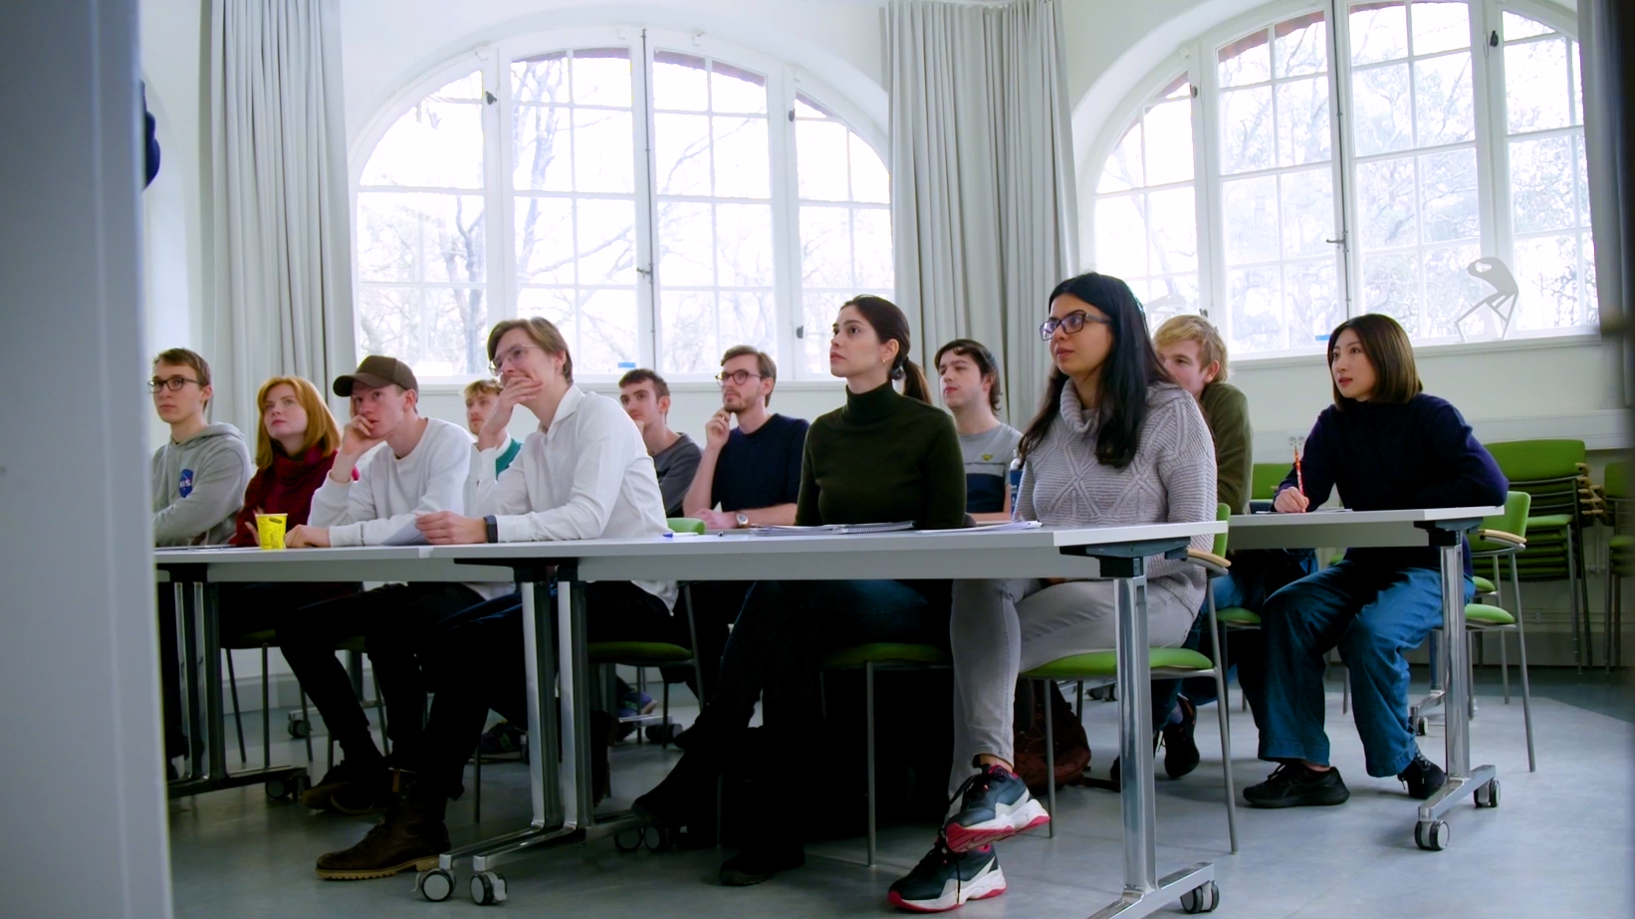
Education
at KTH

Slide 14


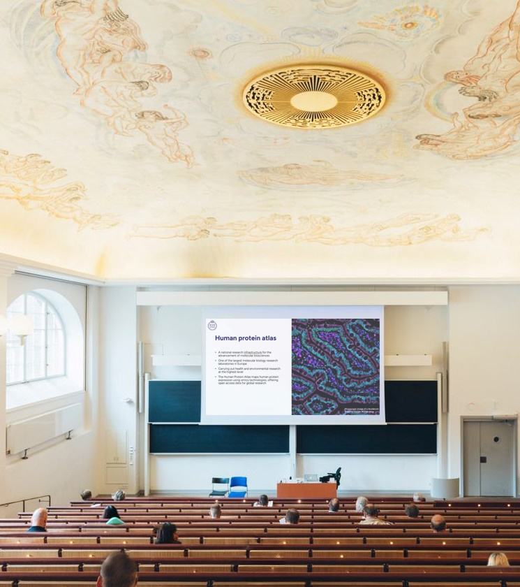
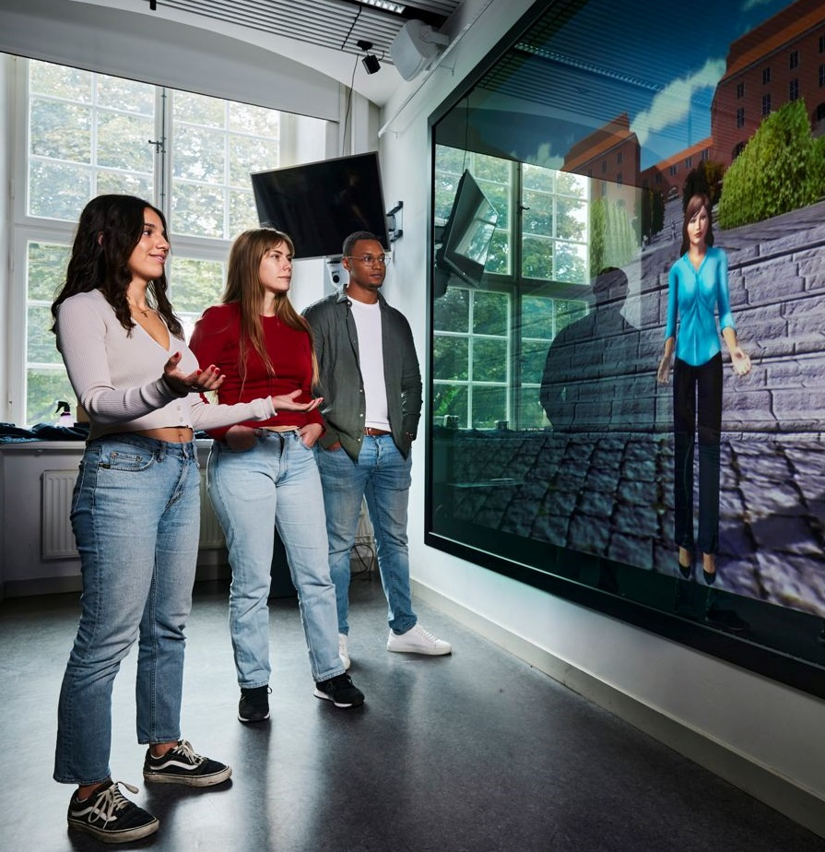
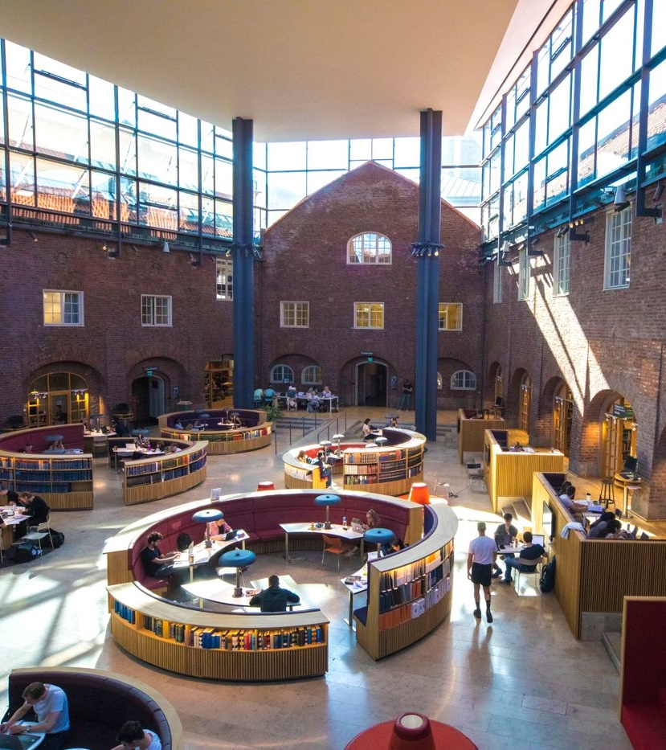


Education for the future
KTH is Sweden's largest technical university
KTH educates engineers, architects and teachers
Approx. 100-degree programmes from qualifying courses to lifelong learning
Leading in innovation and entrepreneurship
Challenge driven education
Sustainability and equality integrated in programme content
Excellent study abroad opportunities
Highly employable graduates worldwide
Notes:
Modern labs
Group study rooms
Makerspaces
Libraries
Lecture halls
KTH is Sweden’s largest technical university and educates architects, teachers and one-third of the country's civil engineers.
The education at KTH is outstanding due to strong academic expertise, innovative teaching methods, and close collaboration with industry. KTH provides a dynamic and stimulating learning environment where students are challenged to solve real-world problems and shape the future of technology and innovation. With a strong emphasis on practical application and international cooperation, KTH prepares students for successful careers in today's global job market.
KTH offers almost 100 degree programmes at first cycle and advanced level that together attract around 25,000 students (headcount) from all round the world.
Lifelong learning KTH’s goal is for lifelong learning to form an integral part of KTH’s education. KTH aims to increase lifelong learning opportunities by offering in-service training courses with government funding. KTH also focuses on meeting the needs of the labor market and internationalization efforts through exchange agreements and strategic partners.
KTH Innovation KTH encourages the development of innovative ideas and an entrepreneurial spirit in students. Both as part of its courses and via its innovation support department, KTH Innovation. (More on KTH Innovation later in this presentation)
Challenge driven education – The challenge driven education at KTH offers an excellent foundation for future careers by allowing students to tackle real-world problems. The programs stay relevant through strong partnerships and with the business sector and society, utilizing the strategic locations of KTH campuses.
Working together in teams at KTH is an integral part of courses and each course always has insights from the very latest research.
Sustainability and equality KTH wants to ensuring a forward-thinking and an inclusive learning environment for all students. Sustainable development is important in all KTH courses and integrated into programmes. Since 2021, all study programmes will include a mandatory part on gender equality and diversity.
Study abroad opportunities- KTH encourage students to study abroad. There is a range of different options to study abroad, such as exchange studies at one of KTH’s over 200 partner universities, degree projects and summer courses abroad.
Highly employable graduates worldwide 97 percent of graduates found a job after completing their degree, over half of whom had actually done so before taking their final exams (career survey 2021).

Slide 15
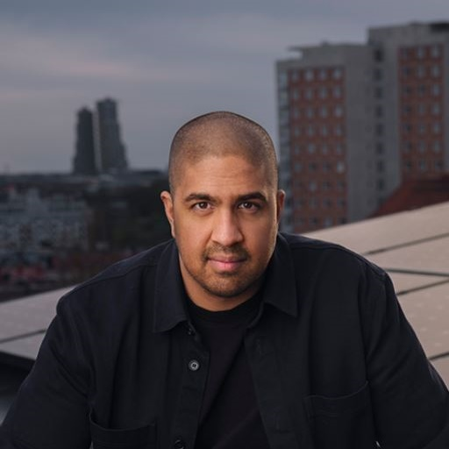
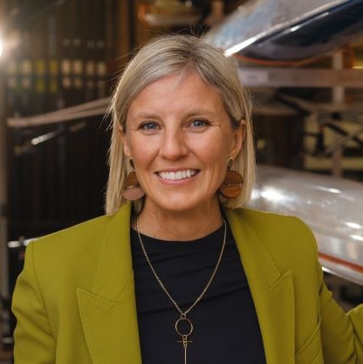
An attractive start to a career
“
“
My studies at KTH gave me a deep understanding of how cities are constructed and how we can plan for more efficient cities and lives in the future. This knowledge helped me develop the idea of how we can live more sustainably in terms of energy use, which led to Greenely, the company I started.
Tanmoi Bari
co-founder of Greenely – a digital energy provider
KTH Alum of the Year 2024
When I went to KTH I didn’t have the self confidence to believe that I would be in the kind of position that I have today. Now I can reflect and say that my KTH time prepared me in a great way for working life.
Karin Rådström
CEO of Daimler Truck – the world’s largest truck manufacturer
KTH Alum of the Year 2025
Notes:
KTH receives high ratings from students according to online reviews.
It has an overall rating of 4.3 out of 5 stars on Mastersportal.com, and 4.1 out of 5 on iAgora.com.
The quotes are from the two most recent recipients of the KTH Alum of the Year award, an annual recognition celebrating a prominent alum who is an inspiration to others.

Slide 16
Education structure
Preporatory
First cycle
Integrated
Technical Preparatory Year
60 credits
Bachelor in Engineering
180 ECTS
Master of Science in Engineering
300 ECTS
Second cycle
Third cycle
Lifelong learning
Master’s programmes
120 ECTS
Doctoral education
240 ECTS
MOOC’s and professional education
Notes:
The Technical Preparatory Year provides eligibility for KTH’s engineering programmes.
Swedish higher education is divided into three cycles: bachelor, master and doctoral.
The Master of Science in Engineering is a five-year professional degree (first + second cycle).
60+ master's programmes taught in English attract international students.

Slide 17
Education at bachelor’s and master’s level
30 programmes at bachelor’s level and 60 master’s programmes within:
Architecture and Built Environment
Engineering Sciences in Chemistry, Biotechnology
and Health
Electrical Engineering
and Computer Science
Industrial Engineering and Management
Engineering Sciences
Notes:
As Sweden’s largest provider of technical courses, study programmes and research, KTH brings together students, teachers and researchers from all over the world.
KTH offer a wide range of programmes on bachelor’s and masters level. 60 masters programmes taught in English.
Mainly in the fields of technology, natural sciences, architecture, industrial economics, social planning and learning. Special focus is placed on digitalisation, sustainability, internationalisation and gender equality, which permeate all activities at KTH.
Architecture and Built Environment
Engineering Sciences in Chemistry, Biotechnology and Health
Electrical Engineering and Computer Science
Industrial Engineering and Management
Engineering Sciences

Slide 18
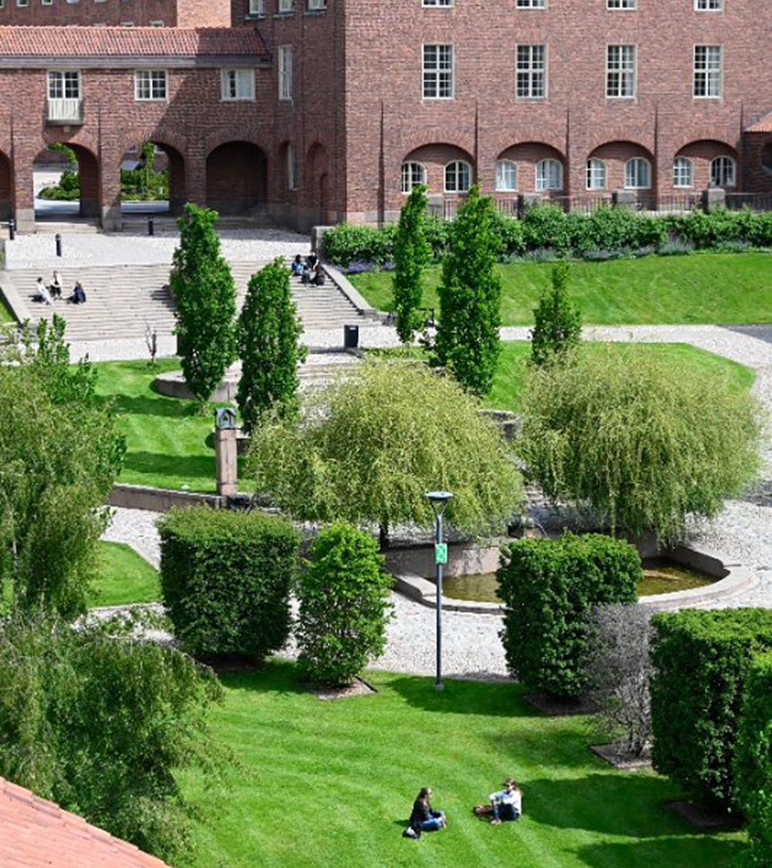
Doctoral studies
In 2024:
277
positions were announced with over 22,000 applicants
275
new doctoral students were admitted of whom 34% were women and 66% men
1,700
doctoral students had activity in postgraduate education
Notes:
KTH provides the opportunity to pursue a PhD degree in a dynamic international research environment, featuring state-of-the-art facilities and close collaborations with industry, the public sector and other leading universities worldwide.
As Sweden's largest and highest-ranking technical university, KTH offers ideal conditions for our doctoral students.
In 2022, 277 (316) doctoral studentships were advertised in 2024. 21,846 people applied, including 6,387 women, 15,394 men and 65 who did not declare their gender. The number of applicants increased in 2024, while the number of posts advertised decreased compared to 2023.
In 2024, 275 (287) newly admitted doctoral students started third-cycle studies, of whom 36 (34) per cent were women and 64 (66) per cent were men.

Slide 19
Student mobility
Most popular countries 2024
Number of students who began student exchange during the year: the ten most popular countries KTH students travel to
Number of students who began student exchange during the year: the most popular countries exchange students originate from
Notes:
In 2024, 672 (previously 6) students embarked on their studies abroad.
Mobility has reached the same levels as before the pandemic, for both incoming and outgoing students. The interest in exchange studies within Europe remains higher than pre-pandemic levels. The most common countries for overseas studies in 2023 were France, Switzerland, Singapore, and the USA.
The interest in studying as an exchange student at KTH continues to be significant. Throughout the year, 1,101 (previously 924) exchange students started their studies at KTH. Within Europe, the majority of these students came from universities in Germany, Switzerland, France, and Spain. Of the incoming exchange students, 380 (previously 305) were from countries outside the EU/EEA/Switzerland, with the largest numbers coming from Singapore, China, Japan, and the USA.
Source:Ladok

Slide 20
Master’s students country of origin
New master’s students 2022-2024
Notes:
The term 'country of origin' refers to the country where the student most recently completed their higher education.
This should not be confused with the student's nationality, although the two may often coincide.

Slide 21

Research
at KTH
Notes:
This picture is showing one of the intricate glass structures created in Professor Michael Fokine’s lab at KTH. His research focuses on how to shape and structure glass in new ways using laser-based techniques. The result is highly precise components for things like optical fibers, sensors, and even 3D-printed glass devices.

Slide 22

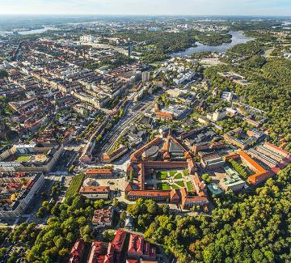

From basic research to societal benefits
The world we live in
Sustainable and secure societal development
People’s lives and health
Notes:
Research at KTH Royal Institute of Technology generates new knowledge and technological development that can lead to significant change – for the world, for society and for people. Our scientific advances are based on the academic freedom to explore the unknown, while at the same time finding solutions that will benefit society. We create understanding of the world we live in and lay the foundations for sustainable and secure societal development, where people’s quality of life and health can be significantly improved.
The world we live in
Scientific discoveries give us a fundamental understanding of the world we live in and what lies beyond the boundaries of our planet, providing us with the necessary knowledge for a sustainable transition and reducing global emissions. It involves energy systems, sustainable materials, and circular production systems that change how we use and manage the Earth's resources.
Sustainable and secure societal development
In step with society’s need for sustainability, research plays a crucial. To meet future challenges, we need secure, robust societal systems with the resilience to withstand and adapt to change. This includes how we build and develop our cities, secure data systems, resource-efficiency, and sustainable and just food systems.
People’s lives and health
Research into people’s lives and health improves quality of life and extends lifespans. An aging and growing population increases our need for cost-effective technology and new methods for diagnosing and treating complex diseases. This includes medical equipment, drug development, individualised care, and the preconditions for a good quality of life.

Slide 23
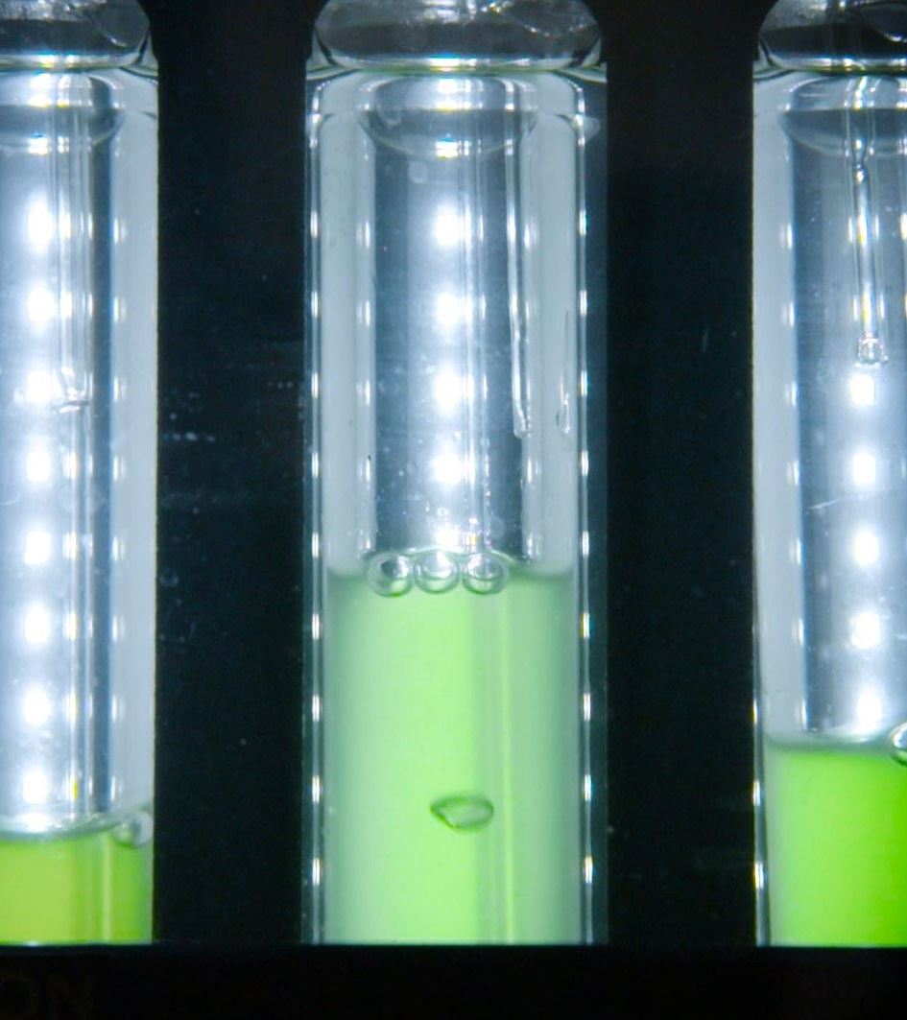
Excellent research
KTH’s research and education spans:
Engineering Sciences
  Digitalisation
  Energy
  Transport
  Materials
  Life Science Technology
  Industrial Transformation
Architecture
Industrial Economics
Urban Planning
History of Technology
Philosophy
Learning
Notes:
The breadth of KTH research requires variation in focus, approach and structuring. We look to create an open atmosphere and to break down traditional barriers between subject disciplines. Pure and applied research are pursued in parallel, and the same goes for multidisciplinary and subject-oriented research.
KTH’s research and education spans:
Engineering Sciences
Digitalisation
Energy
Transport
Materials
Life Science Technology
Industrial Transformation
Architecture
Industrial Economics
Urban Planning
History of Technology
Philosophy
Learning

Slide 24

KTH’s research structures
Enables research and collaboration internally and externally
Strategic
research areas
Research centres
Departments
Wallenberg initiatives
Research infrastructures
Notes:
KTH’S RESEARCH STRUCTURES
Enables research and collaboration internally and externally.
Strategic Research Areas are research areas pinpointed by the government with dedicated government grants to KTH. They include SciLifeLab, SeRC, IT & mobile communication, TRENoP and XPRES.
Research centers are collaboration forms that bring together researchers, research groups and external partners to address specific research questions. The centers can support collaboration, knowledge transfer and can provide administrative and financial support to facilitate research. Centres are often initiated to tackle current problems that needs multidisciplinary solutions.
There are around 50 physical or virtual research centres based at KTH.
The Departments At KTH's 28 departments, research is conducted on both basic and applied level.
Wallenberg initiatives are large programs funded by Knut and Alice Wallenberg Foundation. Each program involves faculty from several KTH departments and includes several universities. They typically fund both faculty, projects, research infrastructure and innovation activities. They include WASP (Wallenberg AI, Autonomous Systems and Software Program), WWSC (Wallenberg Wood Science Center), WISE (Wallenberg Initiative Material Science for Sustainabillity), DDLS (Data-driven Life Science) and WCPR (Wallenberg Centre for Protein Research).
Research infrastructures are equipment and technology resources used to support, facilitate and test research. This may include testbeds, laboratories, or other technical specialised that are necessary to perform advanced research.
EXAMPELS OF OVERLAPS:
Research infrastructures and departments overlap as researchers at the departments use the scientific equipment to conduct their research, from early stages of testing and analyzing to generating end results and building applications.
Research infrastructures and research centres are research-supporting operations, that bring together KTH researchers and external partners. Both the infrastructures and centres offer the possibility of working together by exchanging services and best practice – one focusing on technical equipment and support the other on research questions and knowledge transfer through collaboration.
In the research centres, Wallenberg initiatives, Strategic Research Areas and at the departments, the majority of KTH’s research, societal and academic work is performed. Researchers are always employed at an department, the others being virtual organization forms created to bring researchers from different departments/organizations together.

Slide 25

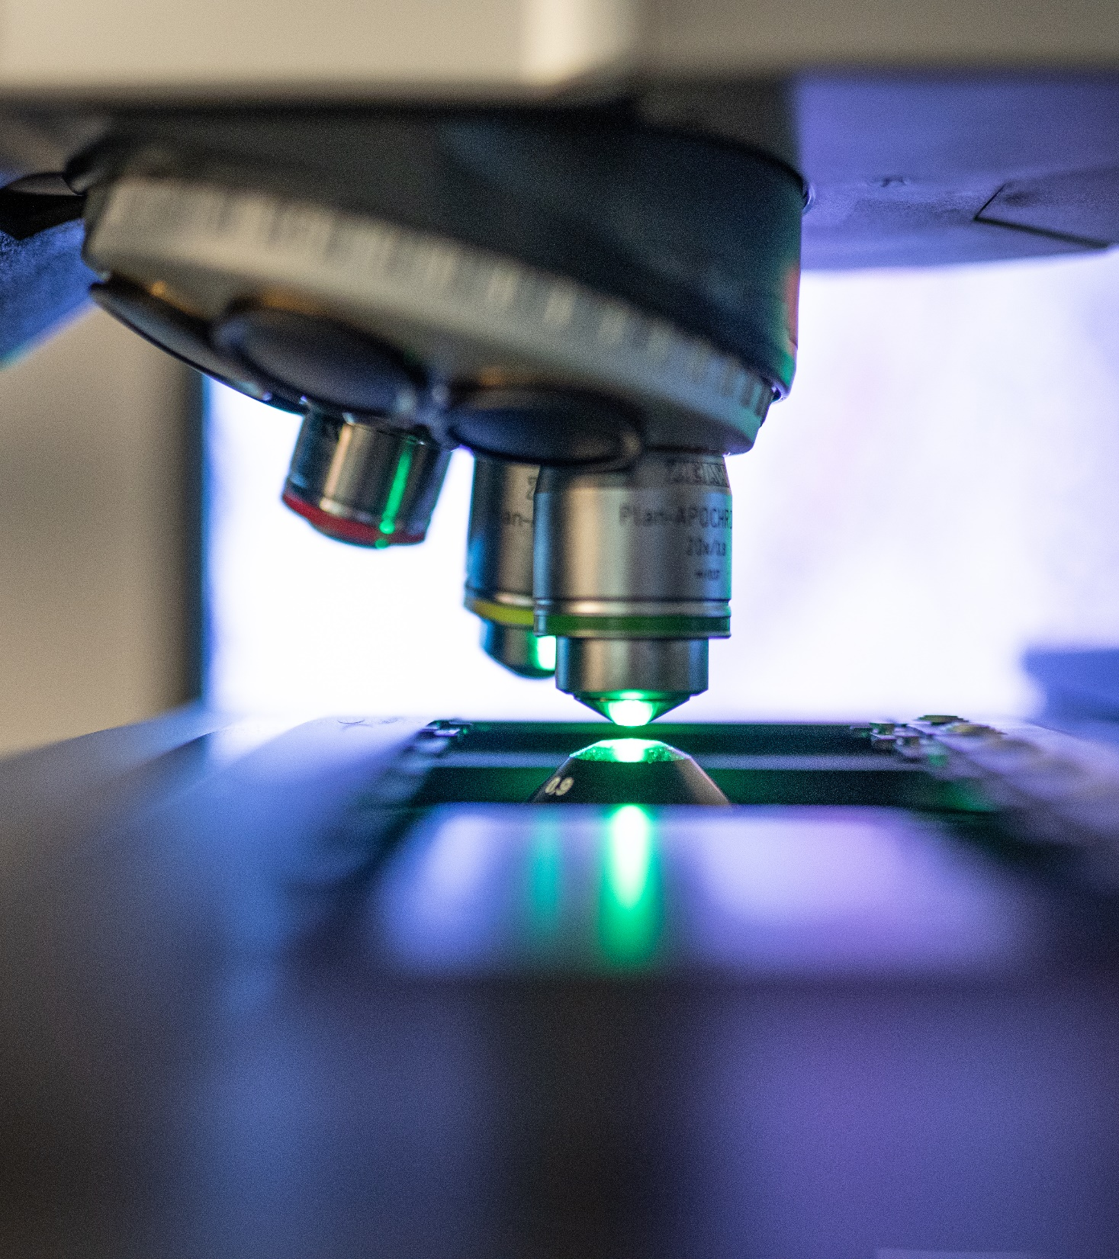

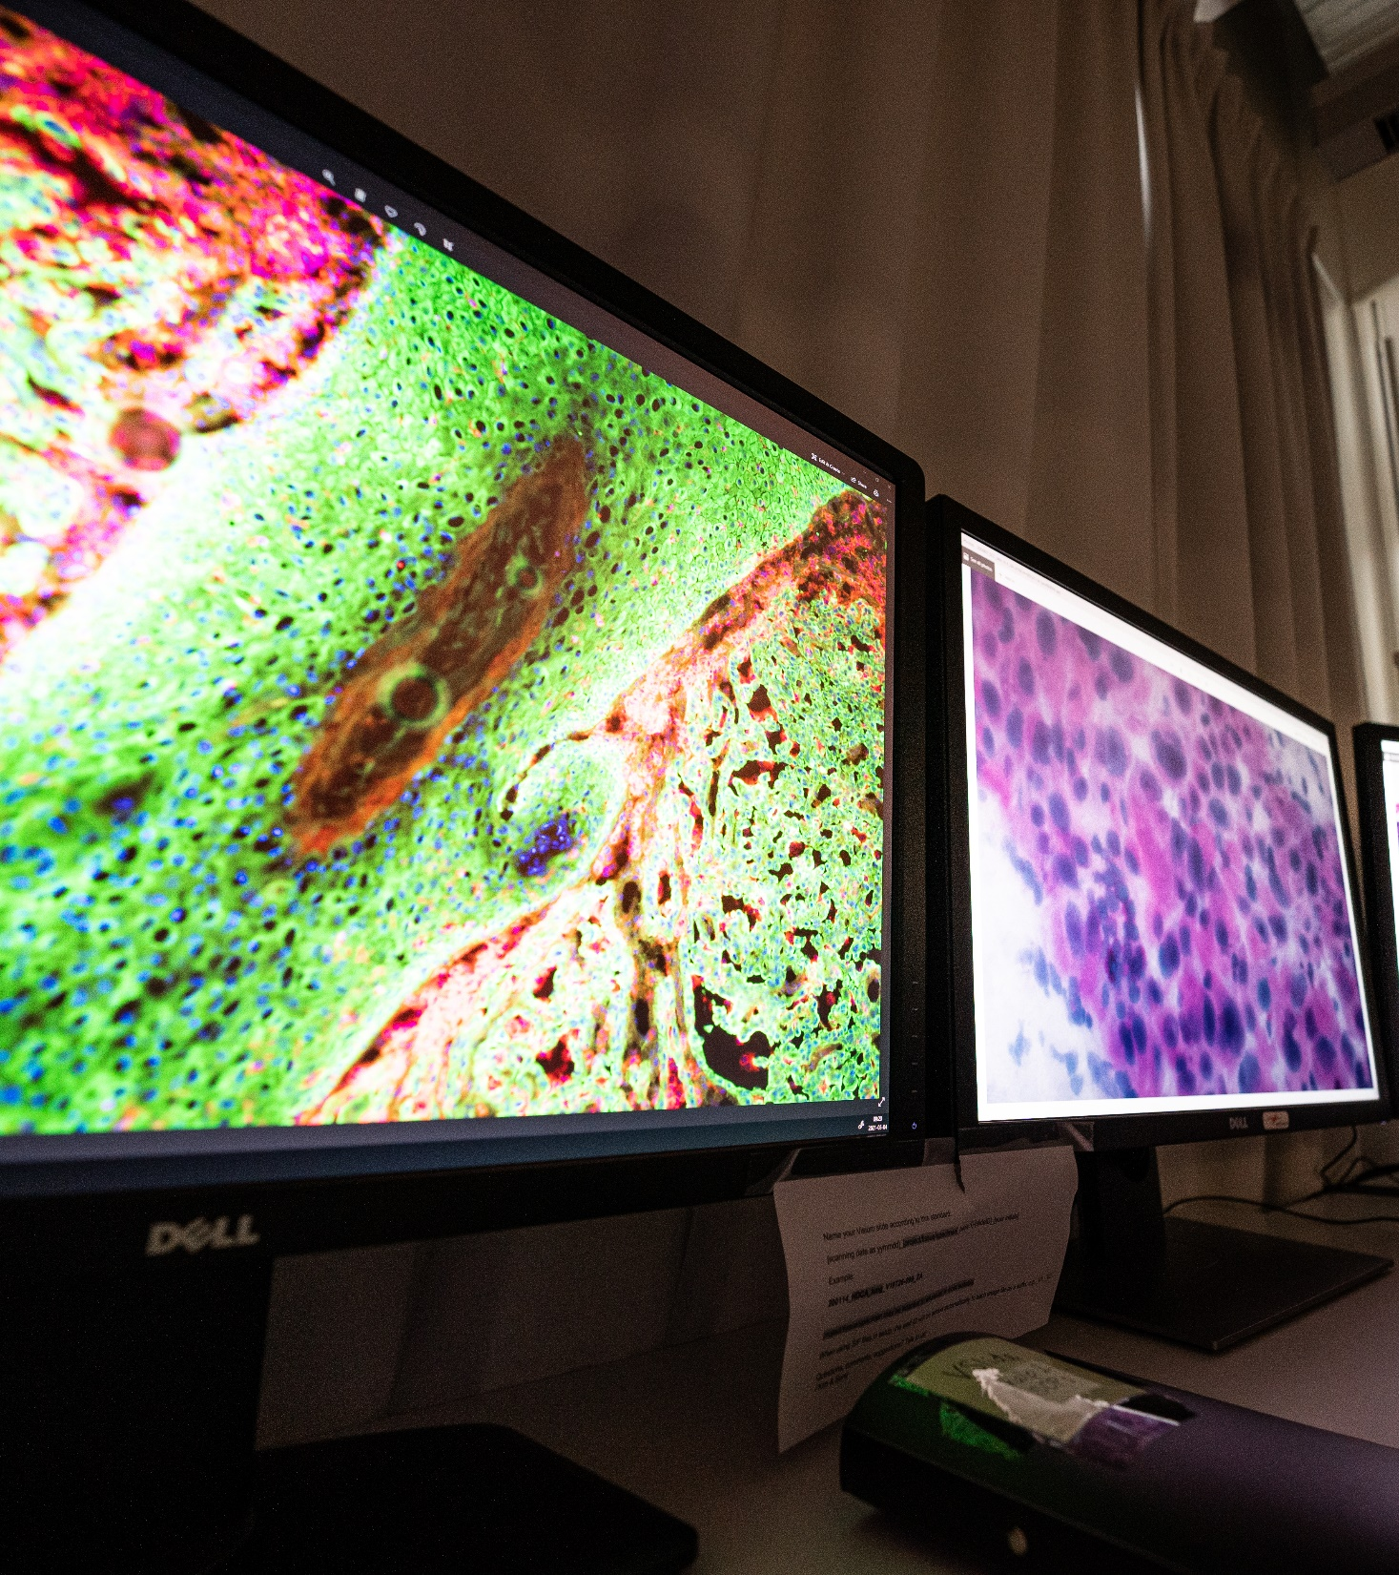
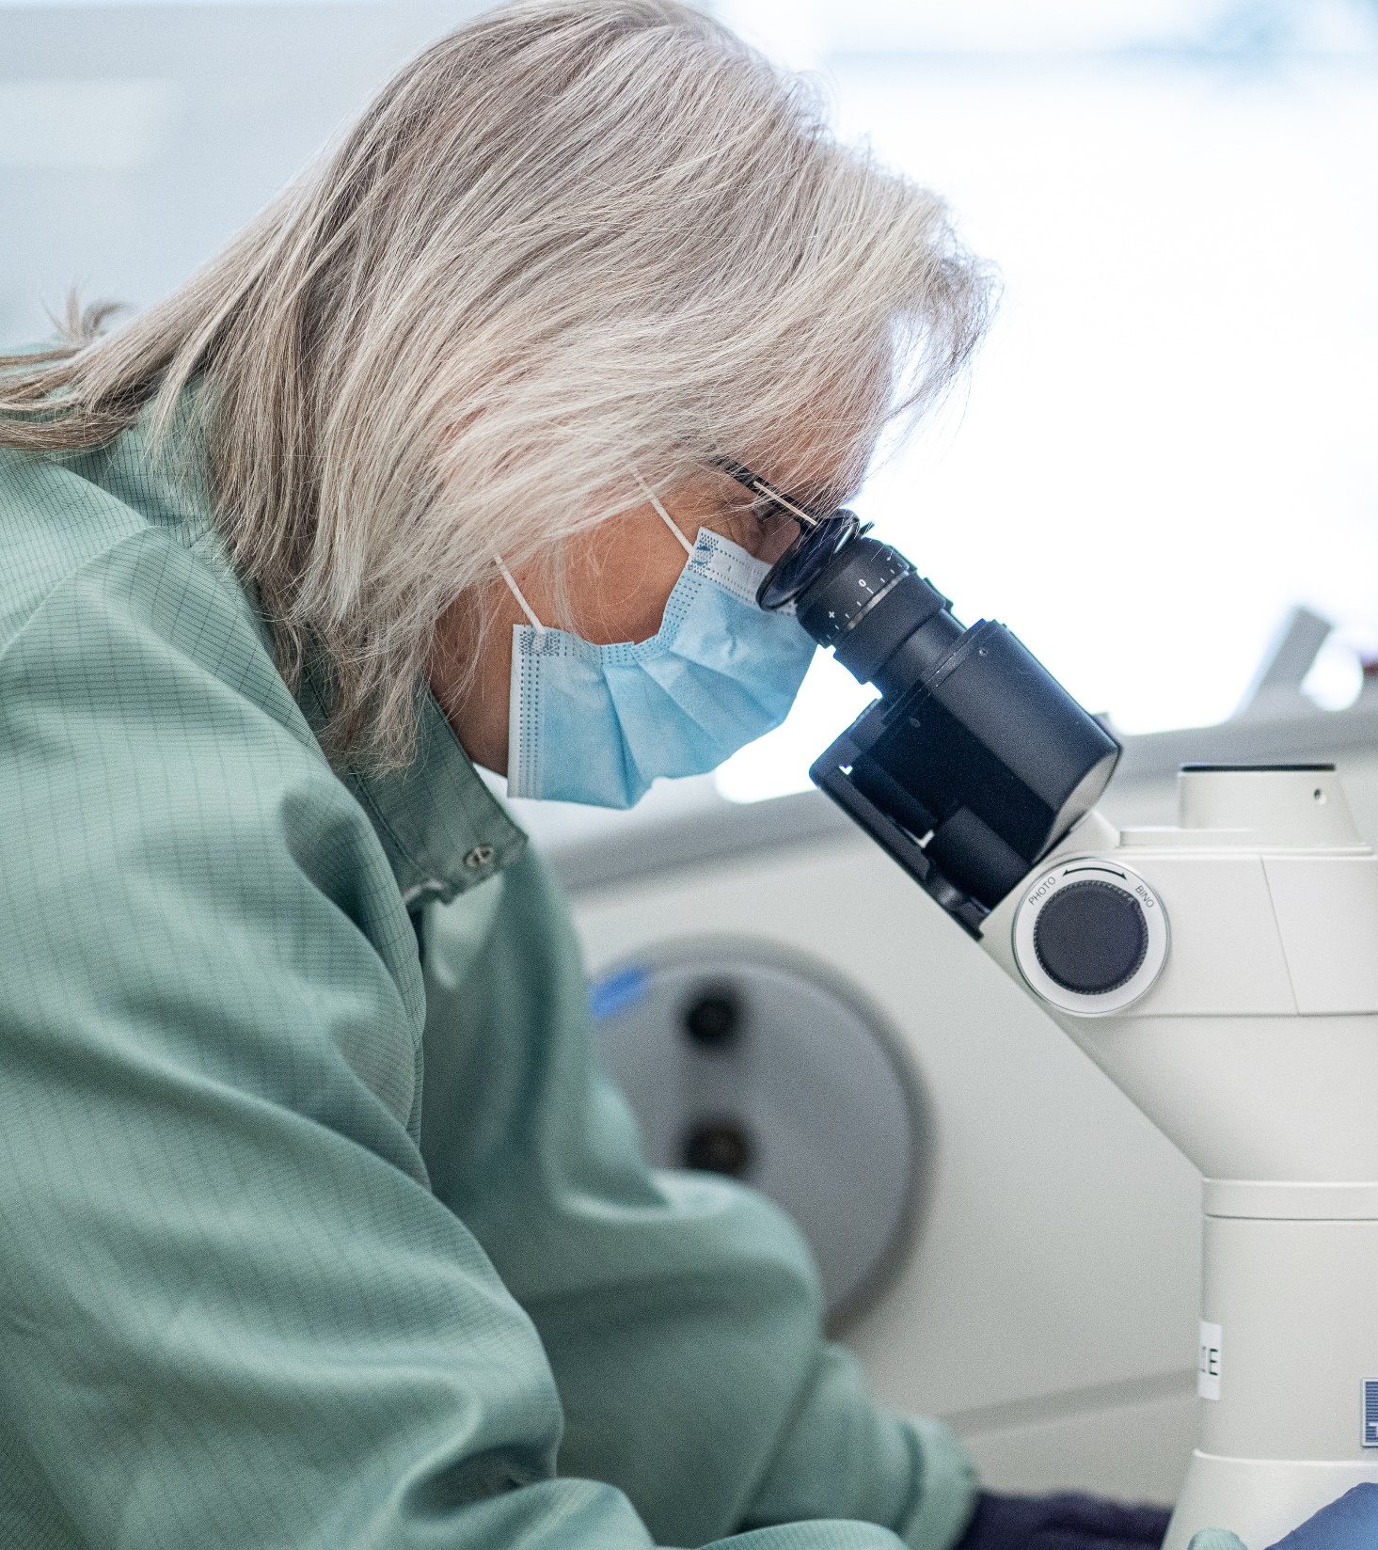
Research infrastructures
National and local impact
KTH is a key contributor research that shapes industries and society
Host of four international and two national infrastructures
Partner in 13 national research infrastructures
Ten research infrastructures strategically established at KTH
Notes:
KTH plays an active role in both national and international research infrastructures.
We host four international and two national infrastructures, and we are partners in another thirteen. These platforms span fields such as genomics, high-performance computing, energy systems and materials science.
In addition, KTH has ten established infrastructures to support key research areas.
These environments are long-term, shared resources that enable high-quality, cross-disciplinary research and often collaboration with industry and other actors.
International research infrastructures
KTH hosts four international research infrastructures. These are part of large-scale European or global efforts and often involve collaboration with organisations such as the European Commission or the United Nations.
Examples include infrastructures in genome analysis, advanced materials and environmental monitoring.
These platforms give researchers at KTH and beyond access to shared data, instruments, and computing resources across borders.
National research infrastructures
KTH hosts or partners with multiple national research infrastructures that are funded by the Swedish Research Council to support interdisciplinary research across institutions throughout Sweden. These national infrastructures offer comprehensive capabilities that enable advanced research.
KTH hosts two national infrastructures and is a partner in another thirteen national infrastructures.
Established research infrastructures
KTH has developed and maintains established research infrastructures to support research within specific fields. These infrastructures are focused and tailored to meet the specific needs of KTH's research community.
KTH's established research infrastructures are strategically designed with a long-term plan for organization, quality assessment, funding, and societal impact. They are easily accessible to multiple users and are frequently utilized.
KTH has eleven internally established infrastructures within four main areas:
ICT
Centre for High Performance Computing PDC
Sustainable Power Lab
Visualization studio VIC
Life Science Technology
Advance Light Microscope Laboratory
National Genomics Infrastructure NGI
Nanofabrication
Electrum Laboratory
NanoLab Albanova
Materials
Hultgren Laboratory
Odqvist Laboratory
2MiLab
Laser Lab

Slide 26
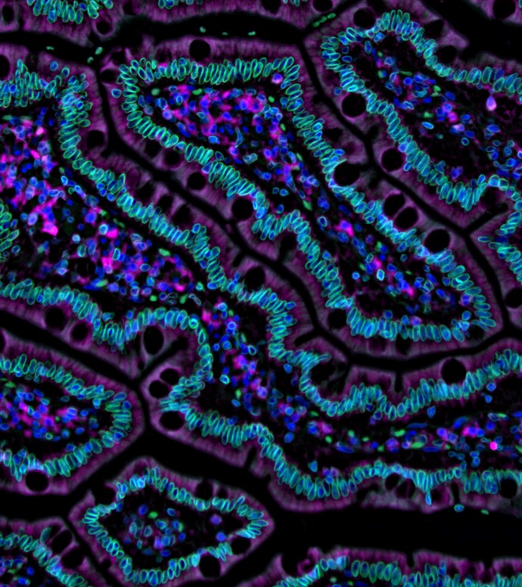
Human protein atlas
A national research infrastructure for the advancement of molecular biosciences
One of the largest molecular biology research laboratories in Europe
Carrying out health and environmental research at the highest level
The Human Protein Atlas maps human protein expression using omics technologies, offering open access data for global research
Microscopic image of a duodenum from the Human Protein Atlas
Notes:
Scilifelab is a world-leading national research infrastructure for large-scale research and one of the largest molecular biology research laboratories in Europe at the forefront of innovation in life sciences research, computational biology, bioinformatics, training and services in molecular biosciences with focus on health and environmental research. The infrastructure combines frontline technical expertise with advanced knowledge of translational medicine and molecular bioscience.
The Human Protein Atlas, located at SciLifeLab, is a comprehensive resource mapping the protein expression in human tissues and cells. The programme started in 2003 with the aim to map all the human proteins in cells, tissues and organs using integration of various omics technologies, including antibody-based imaging, mass spectrometry-based proteomics, transcriptomics and systems biology. All the data in the knowledge resource is open access to allow scientists both in academia and industry to freely access the data for exploration of the human proteome.
SciLifeLab is a joint effort between four of the best ranked institutions in Sweden and Scandinavia; KTH, Karolinska Institutet—the institution that awards the Nobel Prize in Physiology or Medicine, KTH Royal Institute of Technology, Stockholm University and Uppsala University). The National Genomics Infrastructure (NGI) hosted at SciLifeLab offers large-scale DNA sequence data generation and analysis.
SciLifeLab was established in 2010 and was appointed a national center in 2013 by the Swedish government. More than 200 elite research groups composed by 1,600 researchers are associated and work at SciLifeLab's two campuses in Stockholm and Uppsala.
The Stockholm campus is surrounded by one of the largest hospitals in Europe both the old and the new Karolinska University Hospital buildings, the Karolinska Institutet and the European Centre for Disease Prevention and Control.
IMAGE: Microscopic image of a duodenum from the Human Protein Atlas.

Slide 27
Strong contributor in Horizon Europe 2021–2024
Pillars | KTH participants | Highlights of KTH involvement
Excellent Science | 88 | Strong performance in ERC and MSCA grants
Global Challenges & European Industrial Competitiveness | 91 | KTH coordinates 18 projects and contributes to eight EU-missions
Innovative Europe | 8 | Participation in eight EIC projects including coordination of two
189
100
participants
in total
million € granted to KTH
Top 20
Top 2
in Europe
in Sweden
Notes:
KTH is a very active university in Horizon Europe.
Horizon Europe is structured around three main pillars:
1. Excellent Science
World-class research aiming to strengthen and expand competence within the EU’s scientific sphere. Includes ERC, MSCA, and research infrastructures.
With 88 participations in this pillar – including 15 ERC and 61 MSCA grants – KTH demonstrates consistent excellence in highly competitive research calls.
2. Global Challenges and European Industrial Competitiveness
Support for technological and industrial capacity to address global challenges, including prioritisation of key enabling technologies. Includes six thematic clusters.
KTH’s 91 participations in this pillar include coordination of 18 projects and involvement in 8 missions.
3. Innovative Europe
Stimulating market-creating breakthroughs and ecosystems that facilitate innovation, such as the EIC and EIT.
In this pillar, KTH has participated in 8 projects and coordinated 2 within the EIC – indicating increasing engagement in early-stage innovation.

Slide 28
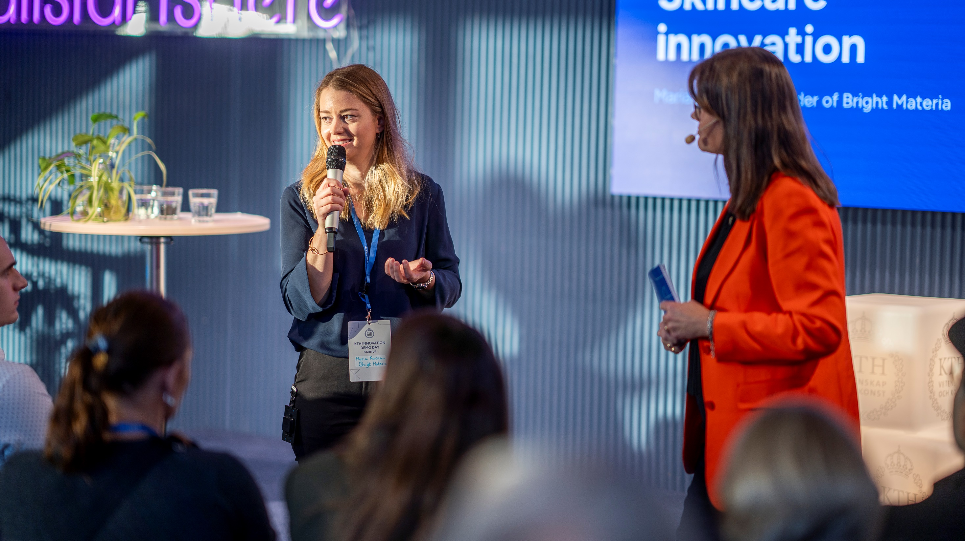
Innovation
at KTH
Notes:
KTH researcher Maria Karlsson presenting the spinoff company Bright Materia at KTH Innovation Demo Day in 2024, an event where successful spinoffs and startups from the university present their solutions to investors and the Stockholm innovation community. Bright Materia is commercializing color- and scent free lignin from waste biomass. Also on stage: Business Coach Eva Halén.

Slide 29
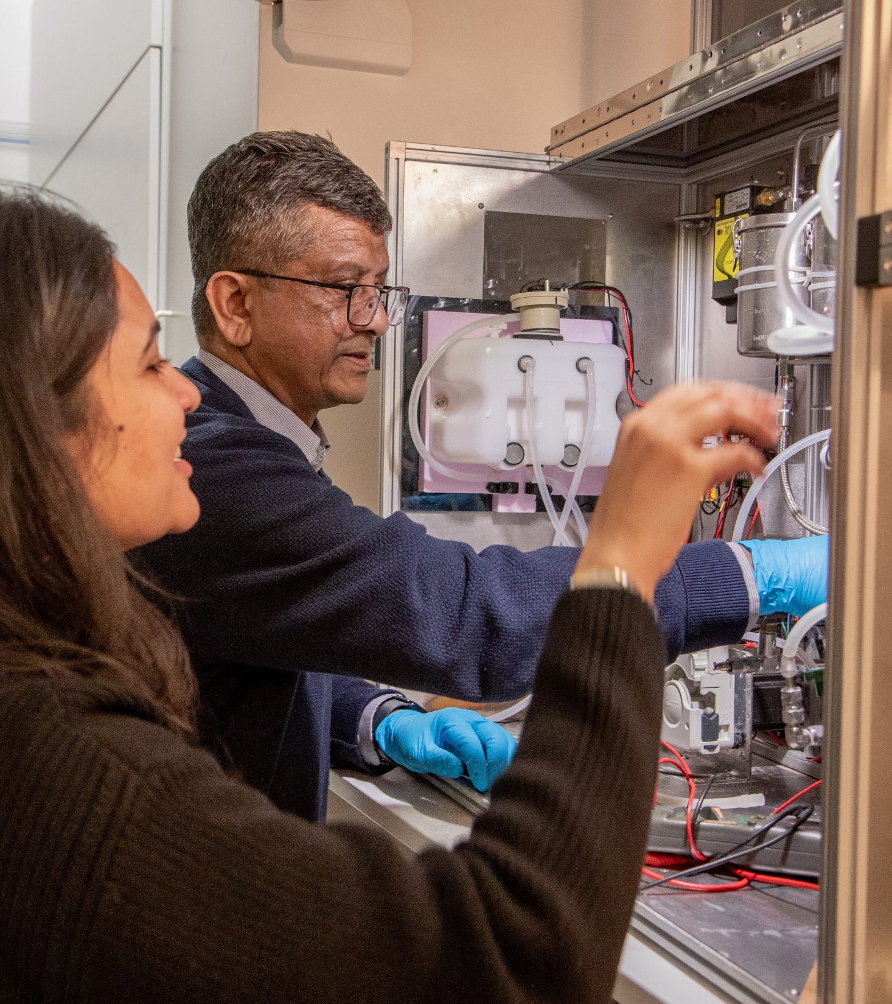
This is KTH Innovation
A leading startup hub
Ranked as one of Europe’s leading startup hubs by the Financial Times.
Support for everyone at KTH
Innovation support for students and researchers, free of charge and with no equity claim. Expertise in deep tech.
KTH Innovation Readiness LevelTM
Open source innovation model used by 3000+ organizations worldwide.
Notes:
Sweden is consistently ranked as one of the most innovative countries worldwide, and Stockholm is known as a global centre for entrepreneurship.
KTH Innovation was founded in 2007 and has since grown to become both nationally and internationally recognized, and ranked as one of Europe’s leading startup hubs (Financial Times 2025). Here, students, researchers and employees at KTH who want to develop an idea or create impact with their research get the support they need to test and grow their ideas.
The support includes personal business development coaching from one of nine highly experienced coaches, access to funding, legal and patent support, recruitment support and network access. KTH Innovation also runs programs for accelerated development, internationalization and mentorship from industry experts. KTH Innovation works with all kinds of technology, and has expertise in deep tech, ideas based on advanced technology.
---
The support is free and confidential and KTH takes no ownership in ideas. In Sweden, all researchers own their own intellectual property under the Professor’s Privilege.
---
The KTH Innovation Readiness Level™ is a complete framework for guiding idea development and assessing idea status across key dimensions. It provides structure and support for idea owners as well as coaches and managers in the development of an early stage idea to an innovation on the market.
The KTH Innovation Readiness Level model was inspired by the NASA Technology Readiness Levels, and spans six areas relevant for innovation development. (technology, business model, intellectual property rights, team, funding and customer).
The model is available under a creative commons licence and is today used by thousands of organizations worldwide, including Vinnova, Imperial College, Aalto, the Technical University of Denmark (DTU) and Chalmers.

Slide 30
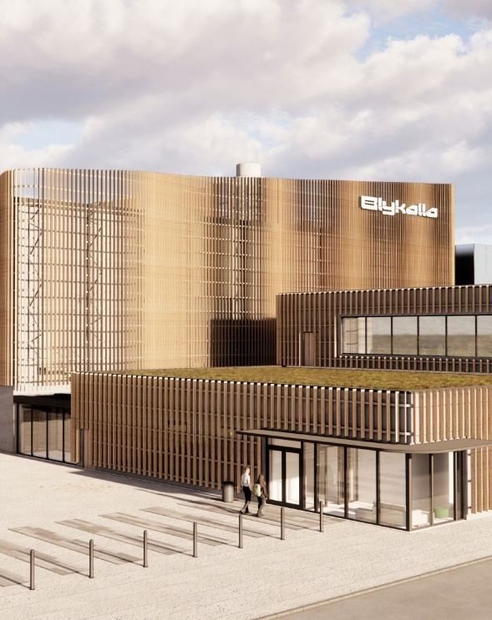
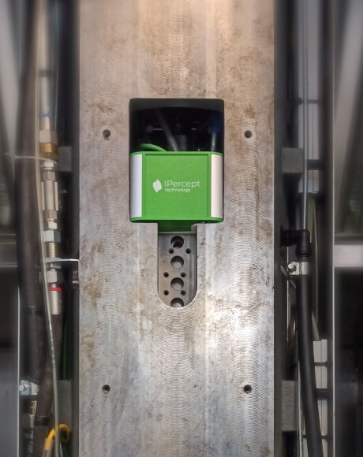
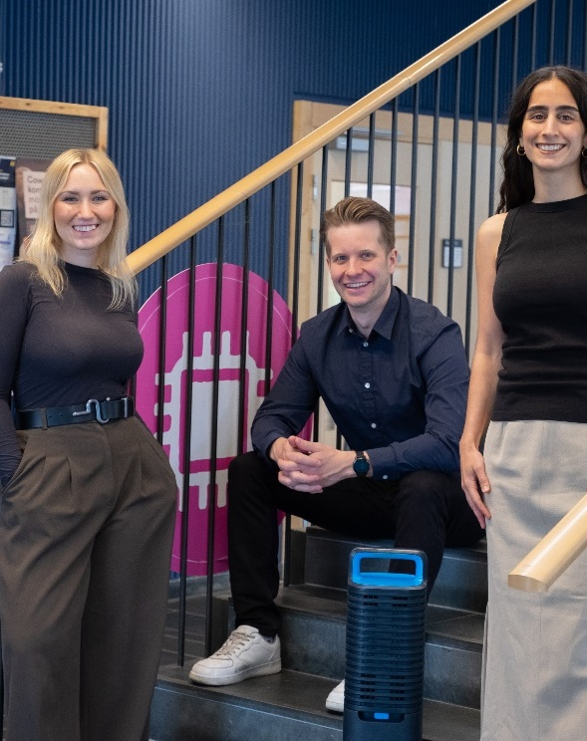

Innovations from KTH
Reserach
spinoff
Blykalla
Developing advanced, small modular reactors (SMRs).
IPercept
AI solution for predictive maintenance of industrial machines.
SimulAir
Machine that lures and traps bed bugs twice as fast as traditional methods.
Lovable
Lets you build software products, using only a chat interface. Founded by KTH Innovation alumni (honorary mention).
Notes:
Blykalla, a spinoff based on KTH research, develops small modular nuclear reactors cooled with led. They are currently working together with global utilities and partners to build Europe's first advanced SMR.
Research spinoff
IPercept is a spinoff from KTH that has developed a "fitness tracker" that can increase the efficiency of machine tools and industrial robots by 20-30%. Their patented technology monitors machine health with sensors and software, and can suggest improvements and reduce downtime. IPercept's solution can be installed in less than an hour and is used by the largest and leading industrial companies in Sweden and Europe. IPercept was founded by Andreas Archenti, professor at KTH, and Károly Szipka, researcher at KTH.
Research spinoff
SimulAir was founded by students at KTH. When Maja Åstrand (on the left) got bed bugs in her dorm room, she learned that she would have to sleep together with the bugs during the extermination process. This led her to build a machine that could attract and trap bed bugs in a thesis project together with Simon Lilja. They later founded the company SimulAir together with Sandra Vahdani.
Student founded
Lovable: Founders Fabian Hedin and Anton Osika both studied at KTH, where they explored several ideas and founded startups. In 2024, the launched Lovable, which quickly grew into one of Europe’s fastest scaling startups. Lovable lets you build software using only a chat interface.
Alumni founded

Slide 31
25-30
startups per year
and close to
500
alumni companies
85%
aim to contribute to
sustainability
40%
has at least one
female co-founder
25%
in deep tech
400
ideas a year
Notes:
Some statistics:​
Every year, the KTH Innovation team meets over 400 teams with new ideas.​
25% of those are deep tech, ideas based on advanced, research-based technology, like quantum, biotech or new materials. ​
40% have at least one female cofounder​
85% aim to contribute to one of more of the Sustainable Development goals​
KTH Innovation helps launch 25-30 startups per year and has close to 500 active alumni companies. ​
Since the start in 2007, over 5000 individuals have received support from KTH Innovation.

Slide 32
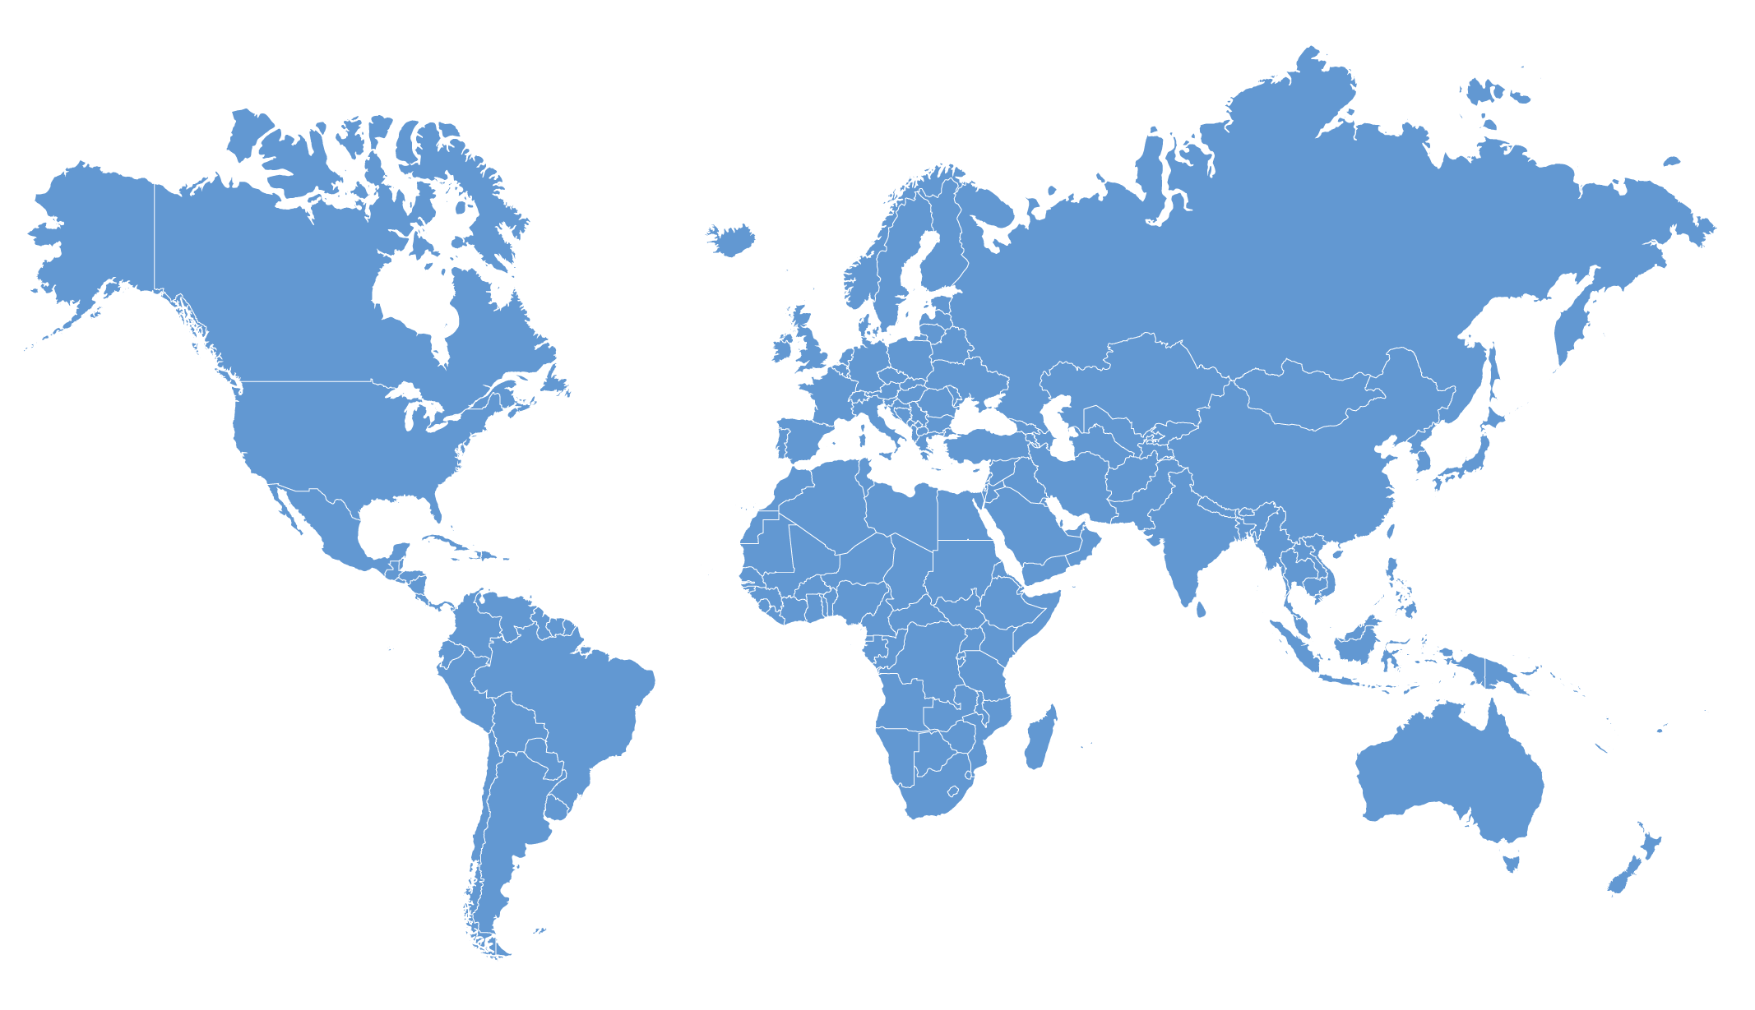
Collaboration
and networks

Slide 33
Collaboration for a better future
KTH will contribute to the transformative journey towards a sustainable society by:
Research & Education
Bringing together different resources and areas of expertise in research and innovation.
Collaborating with industry and other societal stakeholders.
Society
Industry
Notes:
Enhancing societal impact: KTH's collaboration efforts aim to generate high-quality research with tangible benefits for society, addressing pressing challenges and driving positive change.

Slide 34

Collaboration outcomes
Implementation and impact of research findings
Access to advanced research infrastructure
Engagement from an extensive alumni network
Life-long learning partnerships
Work-life connection for students
Students with competencies to meet industry needs
Knowledge exchange through mobility between sectors
Foto: Alstom/KBD Bilder AB
Notes:
By fostering collaborations, KTH enables the translation of research findings into practical solutions, ensuring that innovative ideas are effectively implemented and have a lasting impact.
Access to advanced research infrastructure: Collaboration partners gain valuable access to KTH's state-of-the-art research infrastructure and cutting-edge laboratories, fostering an environment for collaborative exploration, experimentation, and technological advancements.
Extensive alumni network: KTH's extensive alumni network provides a valuable resource for regular interaction and diverse forms of collaboration. Through engagement with alumni, KTH creates opportunities for knowledge exchange, joint projects, and industry partnerships.
Mobility…
Life-long learning…
Work-life connection…

Slide 35












Strategic industry partnerships
Global companies
Public sector
Leading research institutes
Notes:
The aim of strategic partnerships is to develop long-term collaboration for mutual benefit.
The strategic partnerships are a way for KTH to gain better understanding of the challenges and strategies of industry and in society. The long-term commitment and exchange enables important new larger initiatives in research and education, based on this understanding, and develops KTH collaborative capacity.
Together with strong Swedish industrial and public stakeholders the partnerships creates a framework for larger impact – moving society forward.
Advantages for KTH:
Partnerships are a way for KTH to gain better business intelligence on the development, needs, challenges and strategies of important sectors. This enables a stronger development capacity, increases the quality of study programmes and research and boosts innovation capacity in students, teachers and researchers.
Advantages for KTH partners:
Access to knowledge and state of the art research, increased competitiveness and innovation capacity.
KTH has partnerships in three different areas:
1. Global companies – for knowledge development, technology development, know-how provision and greater competitiveness.
2. Public sector – for understanding of and jointly address social challenges and prioritised problem issues.
3. Leading research institutes – for the development and application of knowledge.
Through personal mobility programs, adjunct professors, industry-employed doctoral students, and affiliated faculty share their practical experience and expertise, enriching our academic environment and strengthening our strategic industry partnerships. These kind of exchanges are crucial to develop technologies and solutions of the future.

Slide 36








University networks
University Alliance Stockholm Trio
Notes:
In addition to collaborating with over 200 exchange universities worldwide, KTH is a member of a number of international university networks. These collaborations comprise, for example, a platform for international exchange, development of joint programmes and give KTH bigger opportunities to influence decision-makers concerning higher education at an international level.
Baltech
Baltech is a network for universities in science and technology in the Baltic region and provide a platform for wider partnerships and closer cooperation between member universities.
CESAER
CESAER, the Conference of European Schools for Advanced Engineering Education and Research, acts as the united voice of universities of science and technology in Europe and drives relevant issues at European policy level.
CLUSTER
CLUSTER, the Consortium Linking Universities of Science and Technology for Education and Research, is a consortium of 12 elite European Universities in Science and Engineering.
Deans Forum
KTH is a member of the prestigious network Deans’ Forum together with universities around the world.
The Deans’ Forum is a strategic response from leading engineering schools to the issues that society is facing in the 21st century. From discussions in 2010 between the Dean of the School of Engineering at the University of Tokyo and the Head of Research at IBM-Watson about the complex problems that engineering as a discipline has the opportunity to address, and the crucial role that globally leading engineering schools can play now and in the future, the idea of creating a network of several key institutes was born.
EUA (European University Association)
EUA, the European University Association, has more than 800 members across 48 countries making it the largest and most comprehensive organisation representing universities in Europe.
Magalhães
Magalhães is a network of European, Latin American and Caribbean universities created to promote and support graduate student exchange between the member universities.
Nordic Five Tech
Nordic Five Tech is a strategic alliance consisting of the five leading universities of technology in Denmark, Finland, Norway and Sweden. The alliance was formed in November 2006 with the aim of leveraging common and complementary strengths, and to create synergies within education, research and innovation.
Nordtek
Nordtek is a network that facilitates cooperation between a number of universities of technology in Northern Europe. Its main focus is on bilateral exchanges between the universities in the network.
Scholars at Risk
Scholars at Risk is an international network of higher education institutions and individuals working to protect scholars and promote academic freedom.
T.I.M.E.
T.I.M.E., Top Industrial Managers for Europe, is a network dedicated to the issuing of double diplomas that has been in operation since 1989.
Unite!
Unite! – the University Network for Innovation, Technology and Engineering - consists of seven elite universities in seven European countries. Unite! is part of the European Universities Initiative. The aim is to create a new European university model via joint study programmes, virtual and physical mobility, innovative teaching methods and harmonised governance models. Collaboration has also been extended to research and innovation in 2021.
University Alliance Stockholm Trio
In 2019, the Karolinska Institute, KTH and Stockholm University entered into the Stockholm Trio University Alliance to develop and promote the internationally elite research and education environment that the three universities form in the Stockholm region.
For more information on strategic partnerships with University networks see: https://www.kth.se/en/om/internationellt/natverk

Slide 37
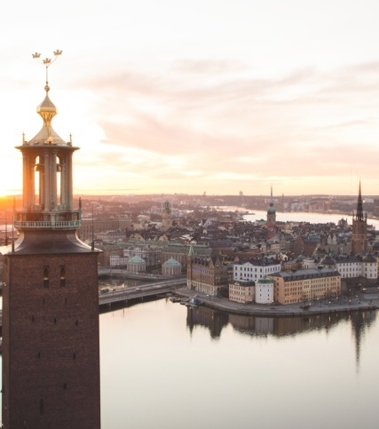
Universitetsalliansen Stockholm Trio
År 2019 bildade Karolinska Institutet, KTH och Stockholms universitet universitetsalliansen Stockholm Trio med syftet att stärka och synliggöra den internationellt ledande forsknings- och utbildningsmiljön som de tre universiteten tillsammans utgör i Stockholmsregionen.
Tillsammans skapar de tre universiteten en komplett akademisk miljö som omfattar medicin, teknik, naturvetenskap, humaniora, juridik och samhällsvetenskap.

Slide 38

European Institute of Innovation and Technology - EIT
Eight EIT Consortia, of which KTH is a member of five:
EIT Digital: for a strong digital Europe
EIT Health: together for a healthy lifestyle in Europe
EIT InnoEnergy: pioneering changes within sustainable energy
EIT RawMaterials: making raw materials an important strength for Europe
EIT Urban Mobility: smart, green and integrated transport
Other EIT:
EIT Climate KIC
EIT Food
EIT Manufacturing
Notes:
EIT, the European Institute of Innovation and Technology, is an EU Agency established in 2008 to strengthen Europe’s ability to innovate and its competitiveness within strategically chosen areas. It is part of Horizon Europe, the EU’s key funding programme for research and innovation.
What does EIT do?
EIT drives innovation across Europe by creating and supporting collaboration between enterprise, education and research within certain strategic knowledge areas. It does this by creating consortia that include partners from leading companies, research institutes and universities, so-called Knowledge and Innovation Communities (KICs).
EIT brings together over 1,000 partners making it the largest innovation network in Europe. The aim is to modernise higher education, increase opportunities for mobility within the parameters of education, create job opportunities and sustainable economic development opportunities for Europe.
The results
Eight KICs
Over 60 innovation hubs in Europe
Over 3,200 new start-ups
Ca 5,000 masters and doctorates awarded
KTH is a partner in five consortia, of which there is fierce competition for selection. The organisational structure and degree of involvement vary between the KICs, but a common denominator for most is that KTH has a huge commitment within joint programmes. We also see more long-term commitment, such as the joint KTH and Uppsala University innovation centre within environmental science and engineering and sustainable energy solutions. KTH also participates in numerous research and innovation projects, which are applied for via annual calls organised by KICs.

Slide 39
Financial information

Slide 40
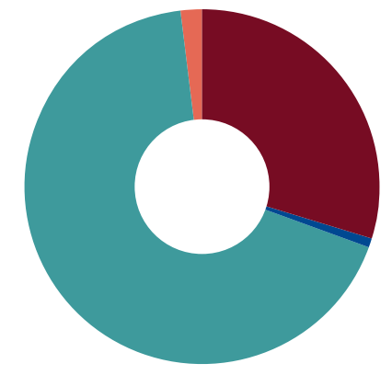
KTH operations 2025 (2024)
Total revenue SEK 6,352 (6,001) million
Distribution, percent |  | 2025 | 2024
 | First and second cycle education | 29,9 | 30,3
 | Commissioned education | 0,0 | 0,1
 | Contract education | 0,8 | 0,4
 | Research and third cycle education | 67,6 | 66,2
 | Contract research | 1,7 | 3,0
Notes:
KTH is a research intensive university. More than two thirds of total funding goes to research. The main reason is KTH’s success in securing external competitive funding, which accounts for more than half of research funding (67.6%).

Slide 41
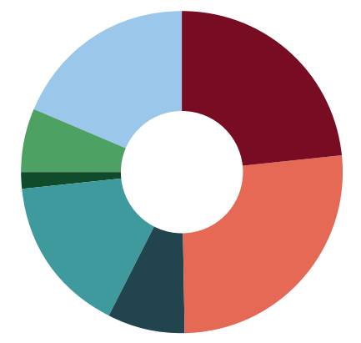
KTH funding 2025 (2024)
Total revenue SEK 6,352 (6,001) million
Distribution, percent |  | 2025 | 2024
 | Government appropriations for research and third cycle education | 23,4 | 24,0
 | Government appropriations for research and third cycle education | 26,4 | 25,1
 | Research councils | 7,7 | 7,6
 | Other government agencies | 16,1 | 16,7
 | Strategic foundations | 1,6 | 2,2
 | EU institutions | 6,2 | 6,4
 | Other and private | 18,6 | 18,0
Notes:
Total revenue increased by SEK 351 million in 2025 to SEK 6,352 million, compared with SEK 6,001 million in 2024, excluding transfers. This corresponds to an increase of 6% compared with 2024. All revenue categories contributed to the increase except financial income. Revenue from government appropriations increased by SEK 219 million, or 7%, of which SEK 115 million related to price and salary adjustments.

Slide 42
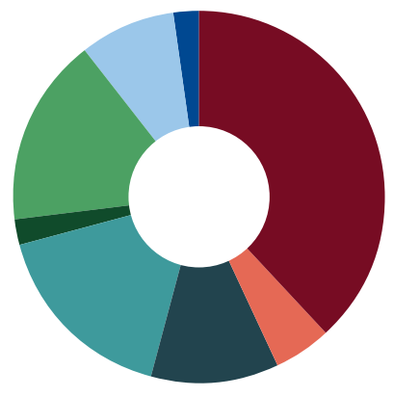
Research funding 2025 (2024)
Total revenue SEK 4,153 (3,848) million
Distribution, percent |  | 2025 | 2024
 | Government appropriations for research and third cycle education | 38,1 | 38,0
 | Vinnova | 5,0 | 4,8
 | Research councils | 11,2 | 11,9
 | Other government agencies | 16,6 | 17,3
 | Strategic foundations | 2,4 | 3,9
 | Swedish companies and organisations | 16,2 | 14,7
 | EU | 8,3 | 7,0
 | Other international sources | 2,2 | 2,4
Notes:
KTH’s revenue from research and third cycle education amounted to SEK 4,397 million in 2025, compared with SEK 4,153 million in 2024. This was an increase of SEK 244 million, or just under 6%. Revenue from research and third cycle education accounted for 69% of KTH’s total revenue, the same share as in 2024.

Slide 43
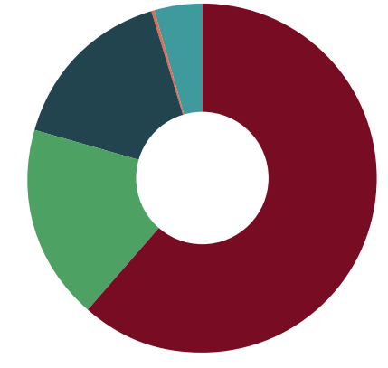
KTH costs 2025 (2024)
Total costs SEK 6,327 (6,106) million
Distribution, percent |  | 2025 | 2024
 | Staff | 61,6 | 61,7
 | Premises | 18,1 | 18,6
 | Other operating costs | 15,8 | 14,9
 | Financial costs | 0,2 | 0,4
 | Depreciation | 4,3 | 4,4
Notes:
Total operating costs amounted to SEK 6,327 million in 2025, compared with SEK 6,106 million in 2024. This was an increase of just under 4% compared with 2024. Staff costs increased by SEK 133 million, or 3.5%. The increase was mainly attributable to annual salary reviews.

